Slide 1
MASS Salary and Benefits Survey
Posted Thursday, April 06, 2017 Results collected November 7, 2017
MASS Public Relations, Member Services and Policy Committee
Notes:
Michele:
The MASS Public Relations, Membership Services and Policy Committee has traditionally collected salaries and benefits of members in the regions and made them available to members.
We didn’t always get all members information and sometimes the information was quite out of date.
The committee decided to survey to collect more current information.
It was important that we collect information in a more general or anonymous way so that members would be comfortable in sharing – our response was really good as a result.
The committee also wondered if members were interested in contract information sessions that used to be offered and this survey gives us some information on that.
Tim and I will present a summary of the findings in a fairly quick run through – this presentation will be followed by table discussion and questions – if you have clarification questions on what we are presenting, just stop us – but we will leave discussions for after the presentation.

Slide 2
83 / 108 = 77% Response Rate
Total Responses
Notes:
Michele:
We were quite happy with a good response rate of 77% overall

Slide 3
Q1: I work in the following geographical setting:
Northern
98% Response Rate
Urban
46% Response Rate
Rural within 90 Minutes
98% Response Rate
Rural further than 90 Minutes
80% Response Rate
Notes:
Michele:
Response was highest in the Northern and rural regions with a lower response from the urban areas.

Slide 4
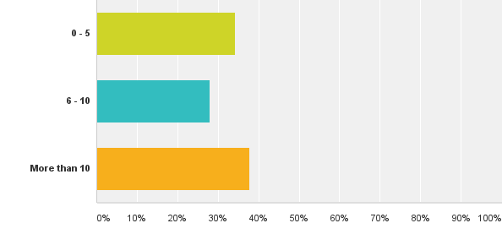
Q2: I have the following years of experience as a senior administrator (including all positions in all divisions)
0 – 5 Years
34%
6 – 10 Years
28%
More than 10 Years
38%
Notes:
Michele:
Our current MASS membership is fairly equally distributed in early (0-5 yrs), mid (6-10) and veteran (more than 10 yrs) career groups. Of note is that we have a very large representation of members in their first 5 years.
With 34% in their first part of their career as a senior administrator, many would be in their first contract and may be getting close to renegotiating their contracts.
Much of the work we have focused on in this area has been with the five years and over experience.

Slide 5
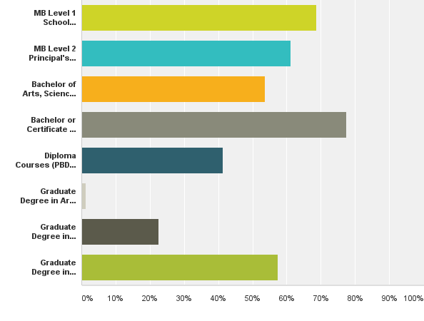
Q3: I have the following educational background: (check off all that apply)
Level 1 Certificate (Old)
69%
Level 2 Certificate (Old)
61%
B.A., B.Sc., etc.
54%
B.Ed., Cert. Ed.
78%
Diplomas, PBDE
41%
Grad Degree in Arts, Science, etc.
1%
Grad Degree in Education (other than Admin)
23%
Grad Degree in Education Administration
58%
Management, Business Admin, ESL, Student Services Coordinator, Special Ed PBDE, Counselling, Theology
Notes:
Michele:
Run through the numbers
It appears that a majority of our members did their contact hours for the soon to be retired Level 1 and Level 2 certificates.
Now the number of our members who have a graduate degree in Ed Admin is almost equal to those with the certificates – one conclusion could be that the universities have made the grad programs more accessible and our members have seen the value of graduate preparation.
Many of you were recently approached to do a survey on the desirability of a new Ed D program being considered at the University of Manitoba. This may be an interesting new option for many of our members who currently hold a Master Degree in Ed Admin.

Slide 6
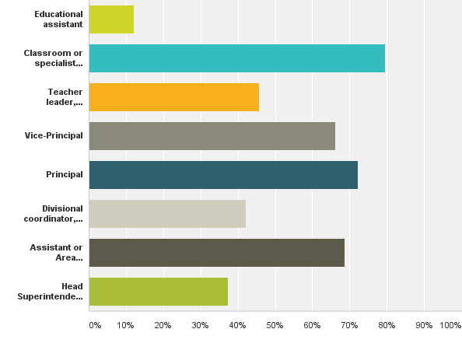
Q4: I have had the following roles in education:
E. A.
12%
Classroom Teacher / Specialist
80%
Teacher / School Level Leadership
46%
V.P.
66%
School Principal
72%
Consultant, Coordinator, Director
42%
Assistant, Area Superintendent
69%
Head Superintendent
37%
Association Director, Department Consultant, Education Director, Secretary Treasurer (dual role)
Notes:
Michele:
This was a questions where respondents were given the option to check all that applied – what it does tell us is that there are multiple pathways to senior administration.
Most of our superintendents have strong classroom and school administration backgrounds – some even serving as educational assistants at some point.

Slide 7
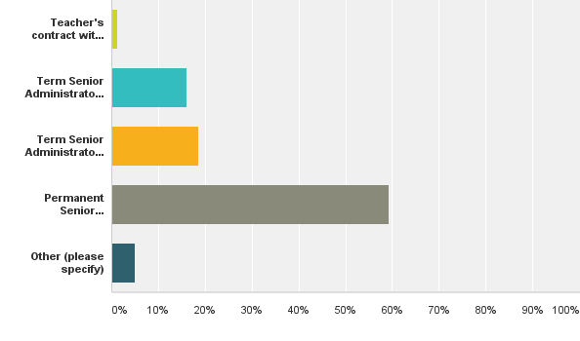
Q5: I have the following type of contract:
Teaching Contract, with Letter/Benefits
1%
Term Contract with End Date Indicated
16%
End date Indicated, with Rollover Provision
19%
Permanent Contract, Termination Clause
59%
Other
5%
No Signed Contract
Notes:
Tim:
One of the areas of interest for members in recent years is the type of contracts that are available and which one might be the most desirable.
If we had done an earlier survey, there would have been a higher percentage of term contracts, as we know that the number of new contracts that are permanent has been on the rise. Currently almost 60% of our members have this type of contract – a permanent contract with a termination clause. One of the reasons for this might be that our lawyer has identified this as the most secure contract.
The concern lies with the 22% of our members who have a term contract, a teaching contract, or no written contract. One of the concerns of a term contract with a fixed end date is that it can be allowed to expire and put such benefits as Long Term Disability at risk.

Slide 8
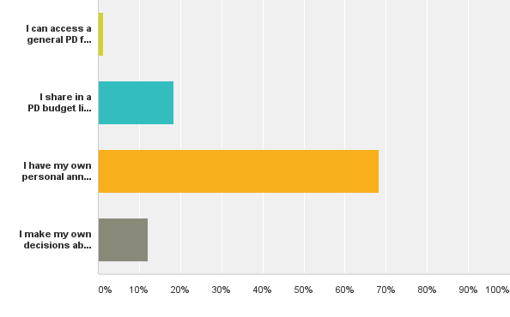
Q6: I have the following provisions for Professional Development:
Access General Fund with Permission
1%
Shared PD Amount is Budgeted
16%
Personal PD Account is Budgeted
68%
No Set Limit to PD - Autonomous
12%
Can access pooled funds, can request additional funds for specific initiatives, no process in place
Notes:
Tim:
From this slide it appears that most of our members have budgeted provisions for professional development.
What differentiates contracts from each other is the amount and the way this money can be used.

Slide 9
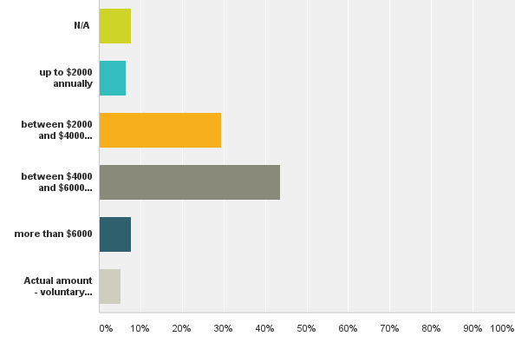
Q7: If you have an annual budget amount for your own professional learning, it would be:
8%
7%
29%
44%
7%
5%
$7500, $8000 plus, smaller amount indicated, but travel and expenses are separate
Notes:
Tim:
From this chart it appears that almost half of our members get between 4 and 6 thousand dollars per year in a pd budget, with the second largest groups getting between 2 and 4 thousand dollars. This may reflect differences in position between head superintendents, assistant superintendents and directors.
We also still don’t know what is all paid for out of the pd fund of each members – for example, some pay their MASS fees out of this amount, some use this amount when going with a divisional team to an event, when attending the MSBA convention in support of the board – items not directly related to self-directed personal professional learning.

Slide 10
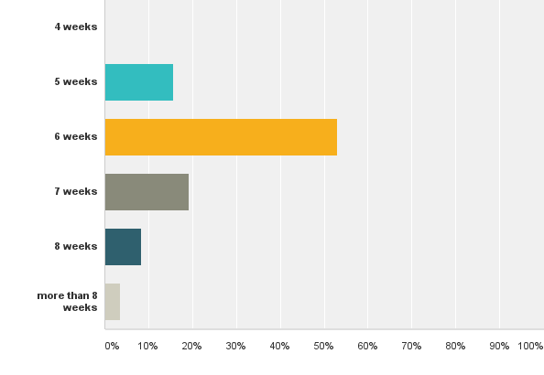
Q8: I receive the following vacation days by contract:
0%
15%
53%
19%
8%
4%
Notes:
Tim:
6 weeks appears to be the “industry standard” – although there seems to be the possibility of moving beyond 6 weeks as contracts are renegotiated.

Slide 11
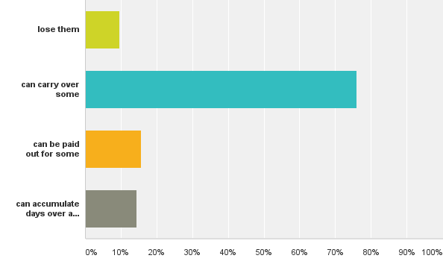
Q9: If I have unused vacation days at the end of the contract year, I...
10%
76%
16%
Can accumulate over the years
15%
Notes:
Tim:
Most of our members can either carry over or get paid out for at least some of the vacation days they do not use.

Slide 12
Q9: If I have unused vacation days at the end of the contract year, I...
Range of specific responses:
No policy direction on this
I need to submit a plan to use up any unused days
Carry over is allowed with written request to Head Superintendent
Payout or carry over is negotiated with the Head Superintendent
Carry over of max of 3 / 5 / 10 / 35 / 50 /one year’s worth/ unlimited number allowed
Carry over up to 5 but only to end of August
Pay out only in exceptional circumstances
Pay out up to 5 / 10 / anything beyond 10 days / all
Up to 50 can be used for retirement
Notes:
Tim:
Responses varied from divisions with no policy on carry over to those that allow unused days to be used towards a retirement fund, with the most common provision being 10 days of carry over or pay out.
This range might be useful for those of you looking at your own provisions and having some sense of where you might be able to ask for improvements. We will be talking about Bill 28 later so this is the kind of improvement that might not be allowed if the Bill becomes law.

Slide 13
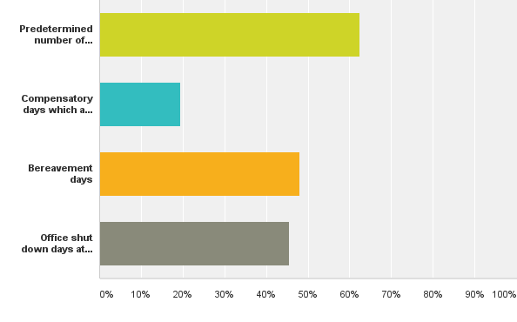
Q10: I receive other leave days by contract:
Predetermined number of days
62%
Compensatory Days determined by extra time
20%
Bereavement Days
48%
Office Closed Days
45%
Notes:
Michele:
All of our members receive some extra leave days such as bereavement, personal leave days and in some cases a set number of discretional leave days for a superintendent to use as needed.
A growing area of interest may be the compensatory days to make up for time spent in evenings at board or committee meetings.
Also, almost half of our divisions close the office at times during the year, especially in summer – some members get this time in addition to vacation time.

Slide 14
Q10: I receive other leave days by contract:
Range of specific responses:
Not specified
Stat Holidays only
Same as teachers’ contract
Banking of up to 80 hours
Any extra days only after all vacation days are gone
Family Medical Days 4 /
Personal Leave 1 / 2 / 3 / 4 / 5 / 8 / 10
Compensatory / days in summer and at Christmas in lieu of board meeting time / 17
Office Closure 8 x .5 / 6 / 7 / 10 / Fridays in Summer / Christmas Break
Bereavement / teachers’ contract / open ended
Notes:
Michele:
These are some of the shared specific responses: read them
Things like personal and bereavement days tend to be tied to teacher or support staff contracts.
Office closed days tend to be Fridays in summer. Some superintendents can use days in summer or at Christmas as compensatory days, whether the office is closed or not.

Slide 15
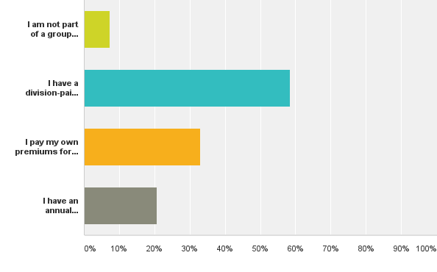
Q11: I have the following health related provisions:
Not part of group plan
7%
Division-paid group plan
59%
I pay premiums for a divisional group plan
33%
I have a self-managed
personal health spending account
21%
I Pay 50% of premiums, Division provides basic life insurance
Notes:
Michele:
Most of our members are on a divisional or self-paid group health plan.
Of interest is that more than 20% have personal health spending accounts that go beyond these group plan provisions.

Slide 16
Q11: I have the following health related provisions:
500/1000/1500/2000/3000/8000
Anything beyond Blue Cross for self or family
Anything that CRA recognizes as tax deductible
Open ended
Anything that contributes to my health and wellbeing
Includes gym membership
Pay 50% of premiums,
Notes:
Michele:
Share some of the comments
For those that have these personal health spending accounts, the most common range is between $1000 - $2000 per year.
They appear to be quite open ended, some including gym membership.

Slide 17
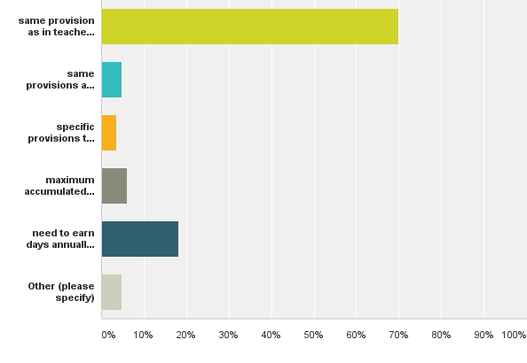
Q12: Sick leave provisions in my contract include...
Same as in teaching contract
70%
Same as support staff contract
5%
Specific provisions in individual contract
4%
Maximum days provided on signing
6%
Earn days annually
18%
Other
5%
Started with 60 days, started with max days, earn 20 – 24 days, max 120 - 130
Notes:
Michele:
Most members are still tied to the provisions of the teaching contract.
Only a small number of new superintendents are provided with the maximum sick leave allotment from the beginning.
When changing employers this might be expected, however, it leaves superintendents very vulnerable as they would have a considerable gap before being eligible for long term disability.
When staying with the same employer in continuous service, it might be expected that earned sick leave would be continuous as well.

Slide 18
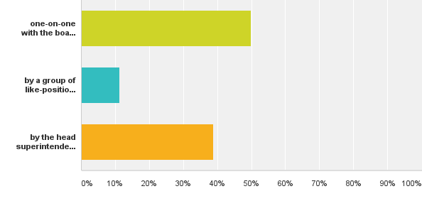
Q13: My salary and benefits are negotiated...
Answered: 80 Skipped: 3
By me with Board / Chair / Committee
50%
By like group with spokesperson
11%
By Head Supt or Sec-Treasurer
39%
Board awards salary and benefit improvements – no input from employee
Notes:
Tim:
Half of our members are negotiating one-on-one with the board or committee of the board.
The second largest group has their contract negotiated by Head Supt or Secretary-Treasurer.
Only 11% bargain in a group.
There are pros and cons to each approach.

Slide 19
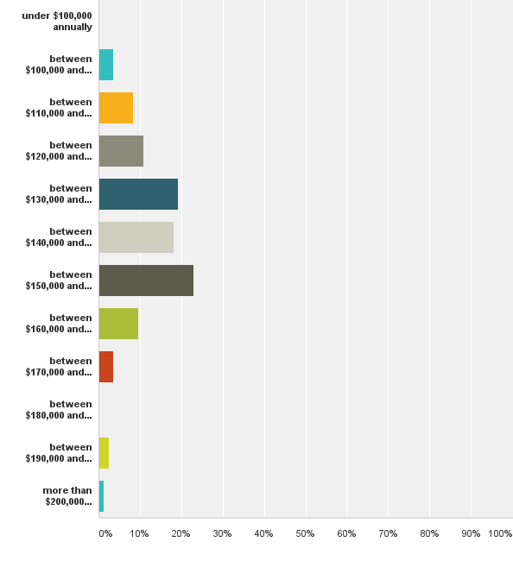
Q14: My salary range is...
0%
4%
8%
11%
19%
18%
23%
10%
4%
0%
2%
1%
Notes:
Tim:
This is the salary distribution for the entire group, with no filtering for years of experience, education levels or geographical region.
The bulk of our members fall in the 130 – 160 thousand range.

Slide 20
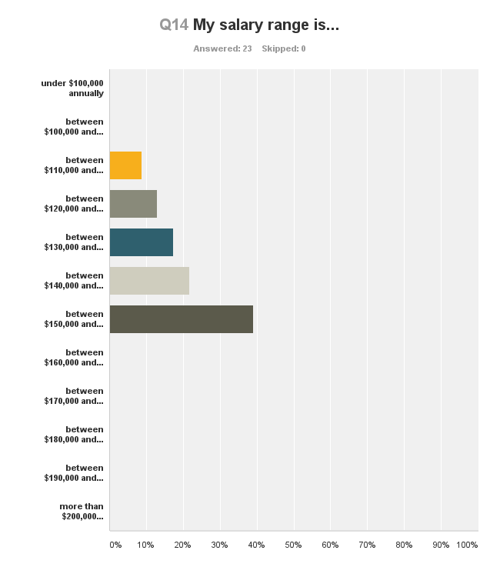
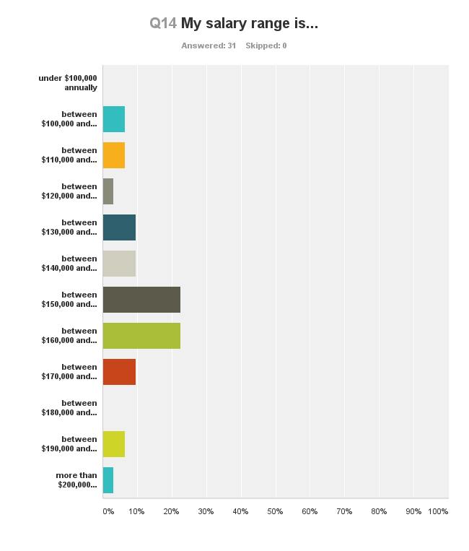
Salary related to length of Service
28 of the 83 respondents are 0-5,
with the majority making between
$120,000-$150,000.
23 of the 83 respondents are 6-10, with the majority making between $130,000-$160,000.
31 of the 83 respondents are over 10 years
of experience, with the majority making
between $140,000 - $180,000.
Notes:
Tim:
Here are the numbers filtered by length of service.
As expected, there is a general strong correlation between length of service and salary.
New superintendents tend to start at the lower end of the salary range for a region but many have experience increments built into a first contract to bring them up into range.

Slide 21
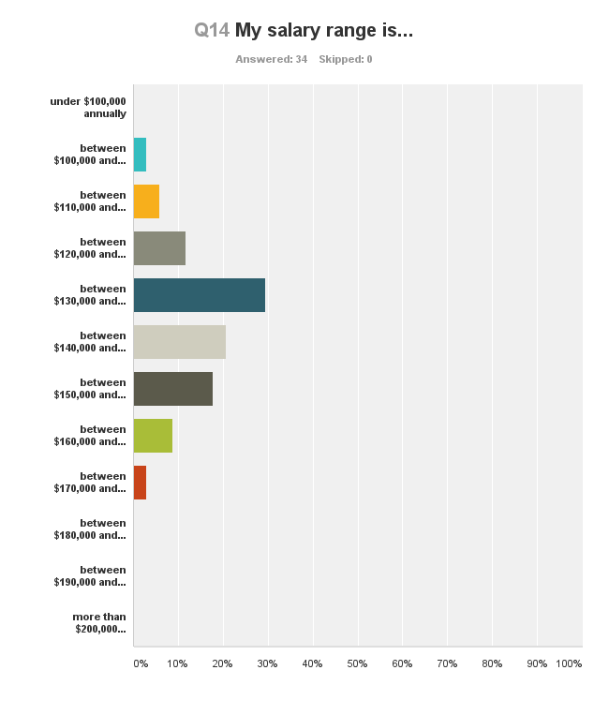
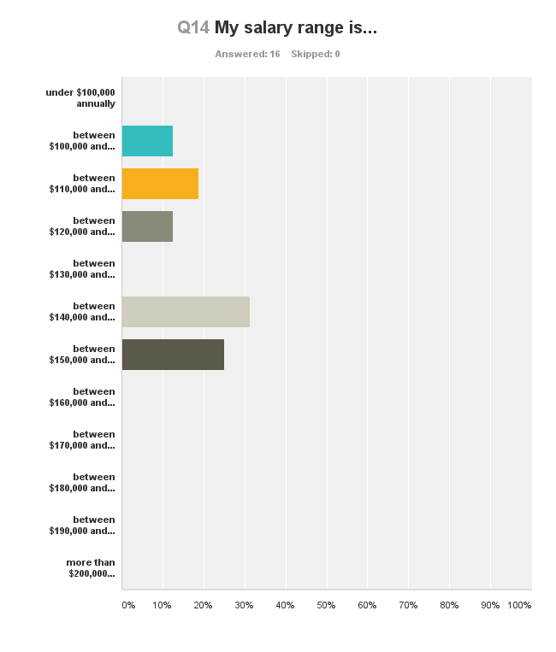
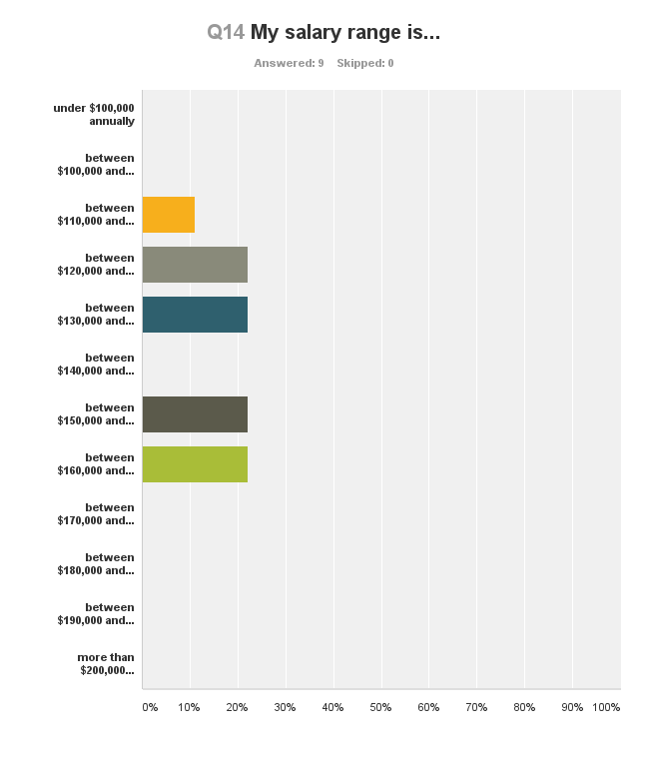
Salary related to Region
Urban
Range 110 – 200+
1/3 in
150 – 160,000 Range
Rural – within 90 min
Range 110 – 180
1/3 in
130 – 140 Range
Rural – beyond 90 min
Range 110 – 160
North
Range 110 - 170
Notes:
Tim:
There is still a clear gap between urban and rural salaries, even in the rural areas near or bordering on urban areas.
It may be helpful for superintendents negotiating to have some sense of the range of salary in their region and how their region compares to the province.

Slide 22
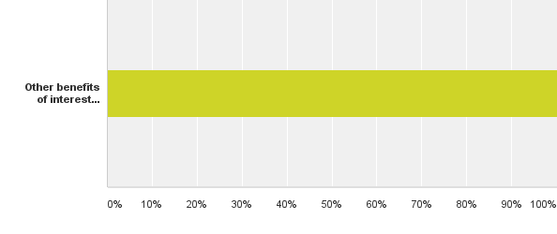
Q15: Do you have other benefits which other members may want to consider in future contract negotiations:
24 Responses
Notes:
Michele:
Only about a quarter of the respondents mentioned additional clauses of interest to MASS members

Slide 23
Q15: Do you have other benefits which other members may want to consider in future contract negotiations:
Range of specific responses:
Divisional vehicle / vehicle allowance / monthly mileage amount / $1000 vehicle amount over mileage claimed
Retirement account (banked sick leave, etc.)
Monthly data Plan and Cellphone / Ipad / Laptop /Printer, Internet at home
MASS membership paid / $100 communication allowance
Books and resources purchased with PL account are personal property
PL Library fund
Release time for university teaching / Grad Studies support / PhD Bursary up to $10,000
Conference per diem
Amalgamation clause / Backward clause
Notes:
Michele:
As expected, the most common are some kind of vehicle allowance and mileage, technology and MASS membership.
Note other areas of interest – maybe release time or compensation for further studies, book allowances
In the light of potential changes coming in Manitoba, of interest might be the amalgamation clause - something that the Finance and Legislation Committee will speak to later.

Slide 24
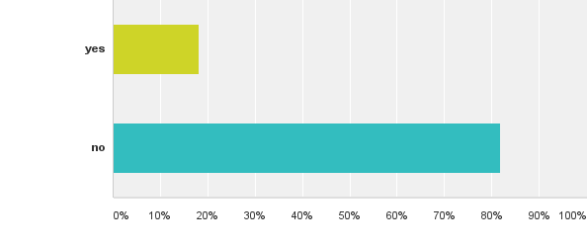
Q16: Did you make use of Rob Olson and the MASS negotiated flat-fee to have your contract vetted by a lawyer, either when you started your first position or when you renegotiated your contract?
18%
82%
Did not know about it / Used existing contract / Just with first contract /
Notes:
Michele:
Only 1/5 of our respondents did use Rob Olson – some indicated they did not know of that option.

Slide 25
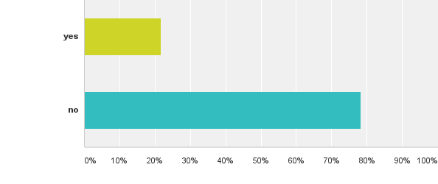
Q17: Did you make use of the services of the MASS Executive Director to read your contract and or to provide an opinion, either when you started or when you renegotiated?
23%
77%
Just for first contract / was directed to Rob Olson
Notes:
Michele:
About the same number contacted Ken.

Slide 26
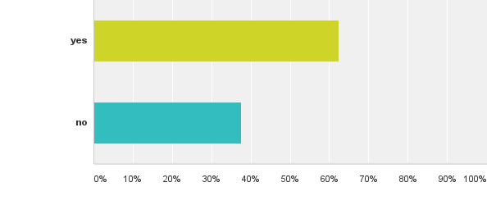
Q18: Would you appreciate/participate in a separate late afternoon/early evening session related to contracts featuring a contact lawyer?
Answered: 80 Skipped: 3
63%
37%
Notes:
Michele:
One of the questions we wanted direction on as a committee was whether we should consider evening contract information sessions – it seems that a majority of our members would be in favour of this.

Slide 27
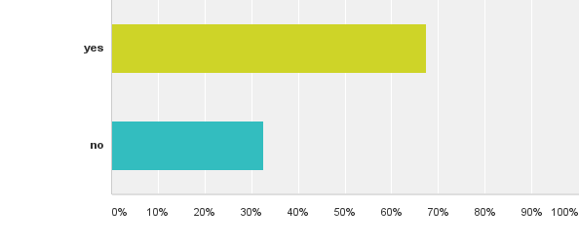
Q19: Would you appreciate a session at a Members Day with senior MASS superintendents facilitating a discussion on contracts?
67%
33%
Wide variety of contracts – may not be helpful / not during members session / yes – due to coming changes
Notes:
Michele:
Whether this would be suitable for a members’ day session, again almost 70% of our members were in favour.

Slide 28
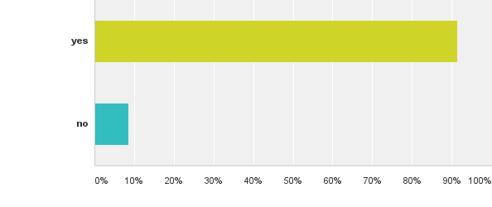
Q20: Would you appreciate a central data base on salaries and benefits which you could access on the MASS website?
91%
9%
For new superintendents, review of contracts for new realities
Notes:
Michele
Share

Slide 29
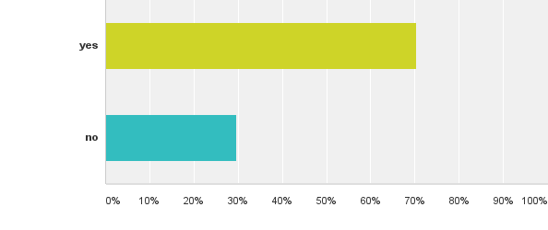
Q21: Would you be willing to submit a copy of your contract (with all identifying information blacked out) – to be available in a secure MASS depository for other MASS members to access?
70%
30%
Just need general info / Metro already does this / yes – relied on MSBA info in the past
Notes:
Michele:
70 % of our members also would be in favour of a central depository of contracts and clauses and would be willing to contribute to that.
Urban superintendents already have a mechanism for this and others rely on MSBA information.

Slide 30
Gender Balance in MASS 1987 – 2016 (not from survey)
Men as % of MASS
90% – 54%
Men as % of Head Superintendents
96% – 62%
Men as % of Assistant/
Area Superintendents
82% – 49%
Notes:
Tim:
Something that was not in the survey but could be of interest to you – Ken has done an analysis of the members directory from 1987 – 2016 to determine gender balance and trends within MASS:
% of males in MASS has dropped from 90 – 54% in thirty years, with the number of head superintendents only dropping to 62% - slightly over-represented.
However, the number of male assistants has dropped to 49%, which is slightly under-represented.

Slide 31
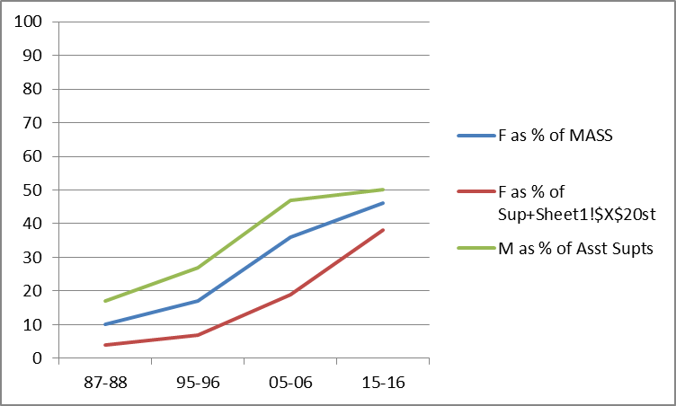
Gender Balance in MASS 1987 – 2016 (not from survey)
Women as % of Mass
10% – 46%
Women as % of Head Superintendents
4% – 38%
Women as % of Assistant Superintendents
18% – 51%
Notes:
Tim:
Women as members of MASS have gone from 10% to 46% in the last 30 years.
Only 38 % are Head Superintendents – up from 4% - a large gain, but still under-represented.
Of note is that women now make up a slight majority of assistant superintendents.

Slide 32
Gender Balance in Metro MASS 1987 – 2016 (not from survey)
Women as % of Metro Mass
21% – 50%
Women as % of Metro
Head Superintendents
10% – 18%
Women as % of Metro
Assistant/Area Superintendents
26% – 57%
Notes:
Tim:
Broken down for Metro, versus Rural:
The number of women as members of MASS Metro Region has risen to 50%, with only 18% as Head Superintendents (Note: Through amalgamation, the number of head superintendents in Metro was reduced)
Women make up almost 60% of assistant / area superintendents in Metro.

Slide 33
Gender Balance in Rural MASS 1987 – 2016 (not from survey)
Women as % of Rural Mass
4% – 44%
Women as % of Rural
Head Superintendents
4% – 38%
Women as % of Rural
Assistant/Areas Superintendents
17% – 50%
Notes:
Tim:
The number of women in MASS rural regions is now 44%, slightly lower than in Metro.
However, 38% of rural head superintendents are now women – still under-represented but gaining ground and half of assistants are women.

Slide 34
Thank You
from the
MASS Public Relations, Members Services and Policy Committee
For your great participation in this survey!

