Slide 1
MASS Finance and Legislation Committee
Bill 28

Slide 2
Bill 28
Impact on Superintendent Contracts
Amalgamation Clauses

Slide 3
Myers Weinberg Summary (Yellow Sheets)
Create a framework of maximum future increases to compensation for public sector employees
To authorize a portion of cost savings identified through collective bargaining to fund increases in compensation or other employee benefits
To support meaningful collective bargaining within the context of fiscal sustainability

Slide 4
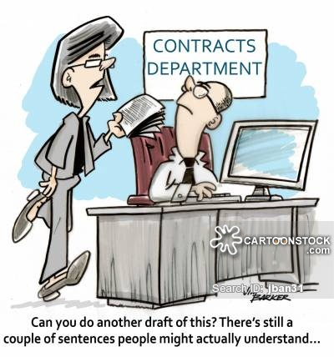

Slide 5
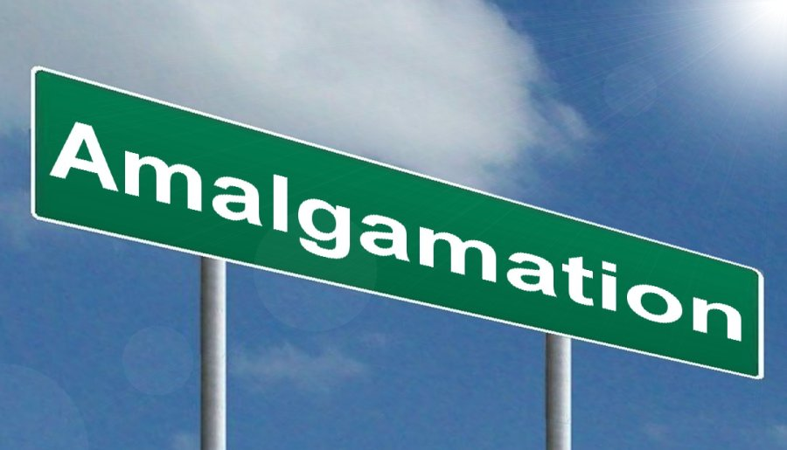
Three Discussion Areas
New Superintendent Contracts
Existing Contracts
Amalgamation Protection Clauses

Slide 6
Process
5-7 minutes per discussion area
Each table assign a recorder
Record as many questions as you have
Attempt to make questions as clear as possible

Slide 7
New Contracts (Green Sheet)
In the Myers summary, it states “Nothing in the Act affects an employee’s entitlement to performance-based increases, step increases or increases as a result of promotion or reclassification within already established collective agreement pay ranges.” Many of our Superintendents negotiate steps or increments in their first 2 – 5 years of service. These are not necessarily based on an established grid or schedule. We currently have new superintendents in the process of negotiating contracts and receiving up to 3 increments over the next 3 years. We are wondering whether these newly negotiated increments will stand if Bill 28 is passed.

Slide 8
Existing Contracts (Pink Sheets)
Many of our Superintendents have reached their maximum on divisional or negotiated grids and are now receiving the same annual increases as other employee groups in the division (teachers)– they do, however, have a wide range of benefits that have cost implications – our understanding of this bill is that any “money” items would also be frozen, except that a Superintendent could bargain for increases to an existing benefit or addition of a new benefit if the salary were reduced accordingly or other benefits were substituted so that the entire pay package would remain at 0% . We are wondering whether we are understanding this correctly.

Slide 9
Existing Contracts (Pink Sheets)
Opening up of contracts – if a superintendent with time left in a multi-year contract were to request the addition of an amalgamation protection clause, would this automatically open up the entire contract for renegotiation and would Bill 28 then apply in terms of salary.
If a Superintendent’s contract is now up for renewal and he or she requests an amalgamation protections clause – would this in any way be seen as a monetary improvement or additional benefit under Bill 28.

Slide 10
Amalgamation Clauses (Buff Sheets)
What impact does an amalgamation clause have in a Superintendent’s contract? Would such a clause provide real protection for a Superintendent in the case of his/her division being amalgamated with another division? If an amalgamated Superintendent were determined to be redundant in a reorganization – would the termination clause in his/her contract determine the outcome?
If an amalgamation clause were advisable, what would an effective amalgamation clause look like?

Slide 11
Thank You

