Slide 1
Balanced Scorecard System
An Introduction for MASS
May 16, 2019

Slide 2
Moonshot Era
Global Forces
Rapid Transformations
We have entered the fourth Industrial Revolution, which is a range of new technologies that combine our physical, digital, and biological worlds.
Impacts are being felt by all disciplines, industries and economies. Manitoba is not immune to these changes.
Notes:
We are just getting started with the possibilities related to Artificial Intelligence, The Internet of Things, Robotics, Blockchain, 3-D Printing, Driverless Vehicles, Smart Cities, etc.
Previous industrial revolutions include: 1. 18th century power generation and mechanical automation (drivers quality of life and engineering sciences); 2. early 20th century mobility industrialization (conveyor belts, large-scale manufacturing, automobiles); 3. Early-Mid 1950s, Electronic Automation (first computers); 4. 21st century Smart and Autonomous Systems

Slide 3
The Manitoba Environment
Forces at Play*
Technology & Service Delivery
Economic Forces
The rapid advancement of technology and its continuing role in innovating service delivery by the private sector creates a widening gap between our traditional approaches to service delivery and what citizens expect.
Our economy is reliant on trade, and as international trade agreements take on a protectionist tone, our provincial policies need to adapt to this new reality.
Unsustainable Status Quo
814k
The slow-growth economy makes it difficult to generate revenues and strategically invest for our future. An aging population and an increase in reliance for public services continues to cause expenditures to increase.
Demographics
People living longer and public service must rethink how to support multi-generations through outcomes-based programs. Labour-force shift due to retirement of Baby Boomers, and availability of skilled workers a challenge.
Public Service Culture
Citizen Expectations
Employees are proud of serving the citizens of Manitoba, but also recognize the need for change.
Manitobans are proud of our diversity and expect government programs and services to address accessibility, inclusion, and reconciliation.
*Transforming the Manitoba Public Service: A Strategy for Action

Slide 4
Call to Action
“The most impactful culture change that is required in government is to become consistently outcome-focused.”
Advisory Panel on Fiscal Performance, 2017
How will we transform our culture?
Notes:
What does it mean to be outcome focused?

Slide 5
Plan to Act
Our vision for the public service is one where public servants embrace challenges and place innovation at the centre of their work to deliver outcomes for Manitobans.
Our strategy is to support this vision with two essential elements:
Transform our work
Transform our culture

Slide 6
Government of Manitoba Transformation Elements
Notes:
Our strategy is to support this vision with two essential elements: 1. Transforming our work; 2. Transforming our culture

Slide 7
The Balanced Scorecard System (BSC)
A system of linked objectives, measures, targets and initiatives, which collectively describe the strategy of an organization and how the strategy can be achieved.
Notes:
Developed over 30 years ago by two Harvard professors, Kaplan and Norton, who looked to discern what made certain organizations successful. They found companies that focused on attaining targets associated with four areas (or perspectives) were more likely to achieve their strategy and sustain long-term success.

Slide 8
The Strategy Execution Puzzle
Why 90% of organizations don’t successfully execute their strategy*
Lack of Behavioural Incentives
Only 25% of managers have incentives linked to strategy
2
Poor Line of Sight
Only 5% of employees understand their organization’s strategy
1
3
Neglected by Management
85% of executive teams spend less than one hour per month discussing strategy
Alignment Barrier
4
60% of organizations don’t link budgets to strategy
*Information adapted from material developed by Robert S. Kaplan & David P. Norton
Notes:
So what’s the alternative? How do organizations successfully achieve strategy execution? And by strategy, I’ll use the Paul Niven definition: Strategy represents the broad priority or priorities adopted by an organization, in recognition of its operating environment and in pursuit of its mission.

Slide 9
Where does balance come into play?
Mission
Strategy
Customers
Internal Processes
Employee Learning & Growth
Financial
“The ‘balance’ refers to broadening traditional performance measures to tell the full story on progress towards reaching all government outcomes.”
- Fred Meier, Clerk of the Executive Council

Slide 10
Balanced Scorecard System – Interlinked Perspectives
CUSTOMER
Who are our customers?
INTERNAL PROCESSES
What business processes do we need to excel at to satisfy our customers and improve outcomes?
FINANCIAL
How do we manage and assign resources to support outcomes for Manitobans?
EMPLOYEE LEARNING & GROWTH
How do we empower employees to become outcome-focused, and understand how they contribute to our purpose?
How do we create impact for our customers?

Slide 11
Manitoba’s Strategic Pyramid
Future Focused
An ideal state we consistently strive for
Why is a scorecard effective?
It creates an informed and engaged organization
Vision
A Balanced Scorecard System facilitates government-wide strategic discussions, which will help to create awareness, build consensus, and support an engaged public service to improve the lives of Manitobans.
Mission & Values
Why we exist
Our guiding principles that demonstrate how we operate each and every day
Government-wide priorities
Statements of what we must do well to execute our strategy
Cabinet Strategy Map & Objectives
Departmental Scorecards and Initiatives
Cascade priorities
Demonstrate alignment with provincial objectives
Measures and Reporting
Regular updates
Are we making a difference?
Notes:
To become more cross-functional and flexible as an organization is a process that needs to be managed.

Slide 12
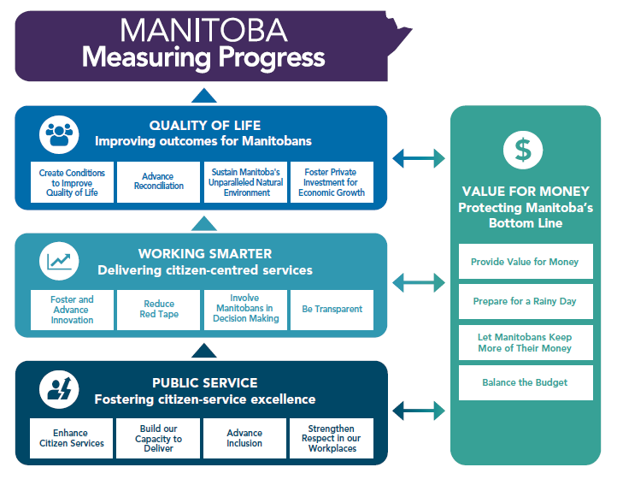
Provincial Strategy Map
A Strategy Map is a key piece of the balance scorecard system. It’s a one-pager that concisely communicates what the public service must do well to execute government’s strategy.

Slide 13
Scorecard Template: Status of Provincial Measures
Objectives
Measures
Targets
Initiatives
100% identified
Notes:
The 16 objectives are outlined in the Cabinet Strategy Map.

Slide 14
Shifting to Outcomes
Improving service delivery the key for guiding The Government of Manitoba into becoming a outcomes-focused organization
In many instances we’re going to start with measuring inputs and outputs, because we don’t have the data to report on outcomes…yet
Discussions happening on how to build capacity within the GoM, to nurture skill sets necessary to better utilize data
Notes:
Outcome-driven design and delivery of services something we haven’t focused on but recognize the need for it.

Slide 15
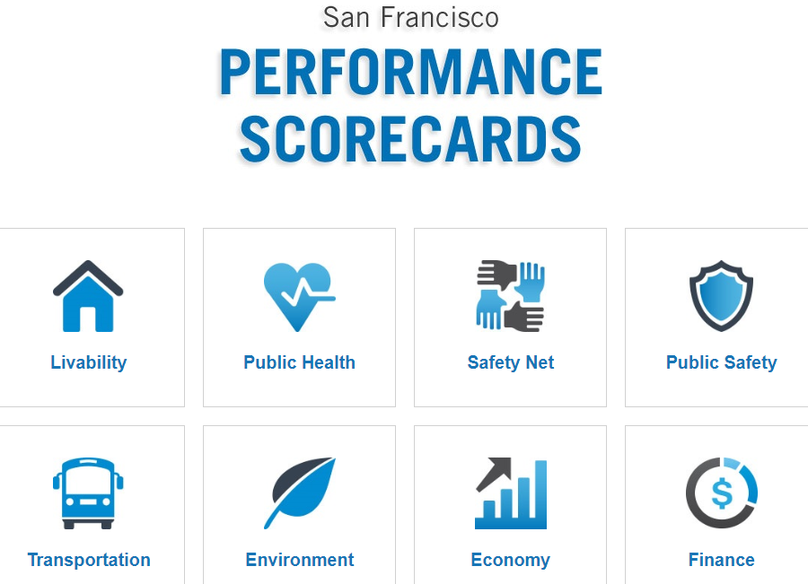
Example – City of San Francisco
Notes:
Priorities for the City of San Francisco. Can see at a glance what they’re focused on from a results perspective.

Slide 16
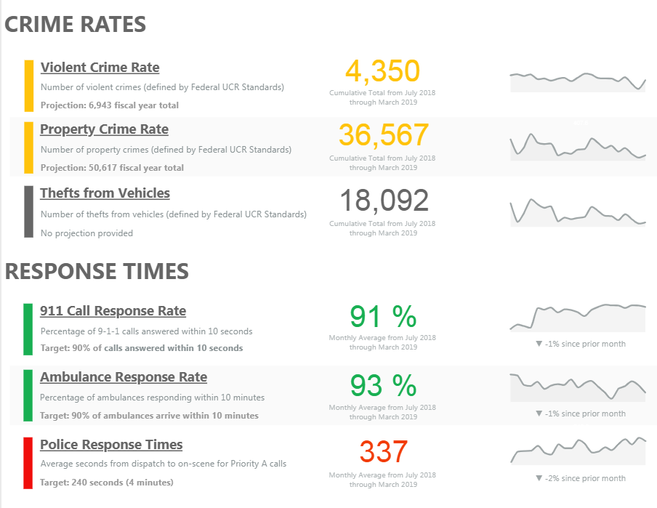

Slide 17
Dashboard Progress
Building a public-facing home for scorecards
Focus groups held with Manitobans validated the importance of communicating methodologies and identifying source data we rely on for our calculations
Performance results featured will be the provincial-level scorecard results

Slide 18
Next Steps
New measures being identified that align to service excellence
Once measures finalized and approved by Cabinet, internal roll-out process will begin
Public-facing dashboard to be launched shortly afterwards

Slide 19
Take Aways
Scorecards supports the transformation of the GoM by shifting our focus to outcome-driven design and delivery of services
Scorecards highlight complex issues we can’t solve without divergent thinking, which requires diversity and inclusion of stakeholders
Scorecards supports working differently, to tackle complex problems together
Notes:
Design thinking, or human-centred design thinking, is a process for creative problem solving. It helps organizations put the client or customer at the heart of their service or product they’re designing, which leads to better internal processes, services and outcomes.

Slide 20
Thank You
Questions?
Contact me with follow-up thoughts!
Tel: 204.792.7326
Email: kelly.fournel@gov.mb.ca

